Slide 1

Objectives:
distinguish between ‘normal’ & ‘inferior’ good
distinguish between ‘substitute goods’/ competitive demand & ‘complement’ / joint demand goods
Meaning of composite demand and derived demand
distinguish between ‘competitive ‘& ‘joint’ supply

Slide 2
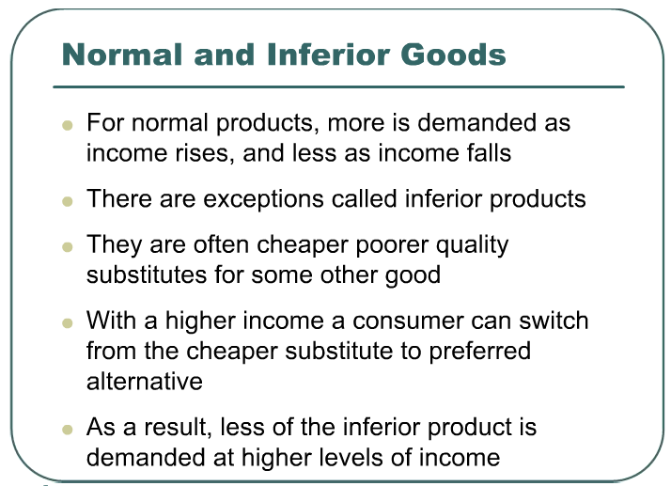

Slide 3

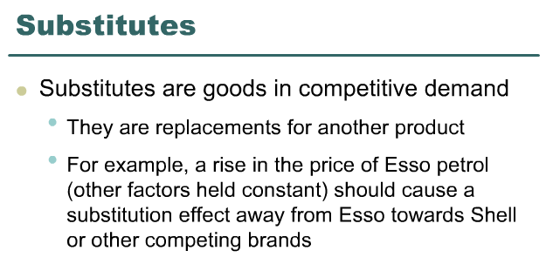

Slide 4
Substitutes
A rise in the price of one good will lead to an increase in demand and a rise in the price of a substitute good
A rise in the price of beef causes an increase in the demand for lamb as consumers substitute lamb for beef. This leads to a rise in the price of lamb and a rise in quantity purchased

Slide 5
Complements
Goods in joint demand
In demanding one good, a consumer will also be likely to demand another good
Tennis racket and tennis balls, washing machine and soap powder, pen and ink
A rise in the quantity demanded of one complement will lead to an increase in the demand for another, resulting in an increase in the price and quantity bought of the other complement

Slide 6


Slide 7
Derived demand
Many goods are demanded only because they are needed for the production of other goods
Demand for flour is derived in part for the demand for cakes and bread
An increase in demand for a good will lead to an increase in price and quantity purchased of goods which are in derived demand from it

Slide 8
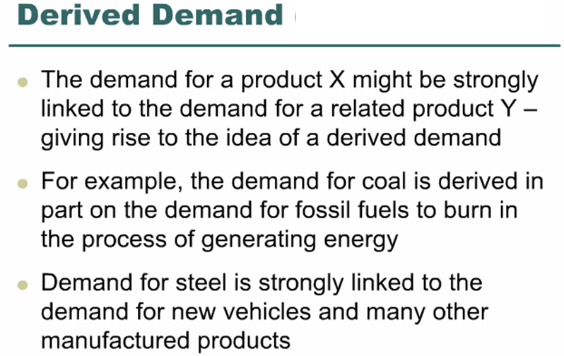

Slide 9
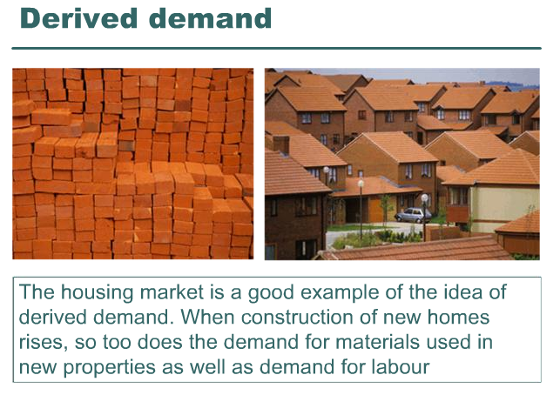

Slide 10
Composite demand
When a good is demanded for two or more distinct uses
Milk may be used for yoghurt, for cheese making, for butter or for drinking
An increase in the demand for one composite good will lead to a fall in the supply of another
An increase in the demand for oil from chemical producers will result in a fall in the supply of oil to the petrol market. Price of oil in the petrol market will rise and the quantity purchased will fall

Slide 11
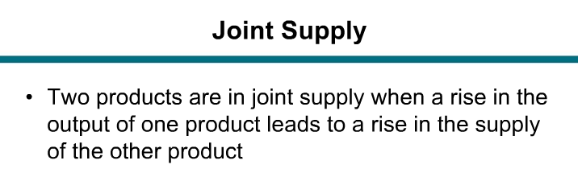

Slide 12
Joint supply
When one good is supplied for two different purposes
Cows are supplied for both beef and leather, an oil well may give both oil and gas (by-products)
An increase in the demand for beef, which leads to more beef being produced, results in an increase in the supply of leather.

Slide 13
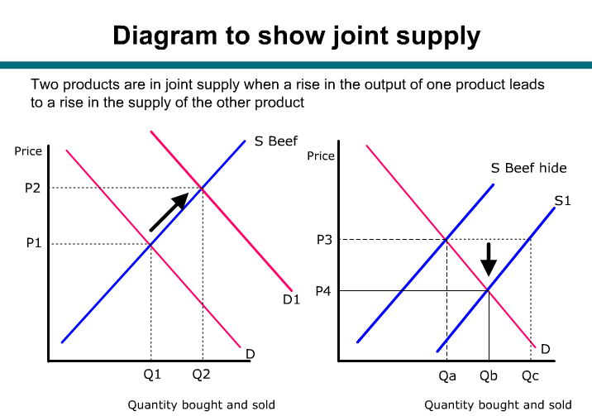

Slide 14
Competitive supply
Alternatives in production
Firms will switch to an alternative good if
  the price of the alternative good rises and /or
  The cost of producing the alternative falls
  These changes make the alternative good more profitable
  Palm oil and rubber

Slide 15
Activity
Identify the type of good based on the explanation below
Goods which are consumed together
The demand for the input depends on the demand for the final goods it
produces
Goods that are considered as rivals in consumption
Goods that are demanded for more than one use
As income rises demand for these goods fall
As income increases demand for these goods rises
Goods which are alternates in production
Goods which are produced together i.e when one good is produced for two different purposes

